Slide 1
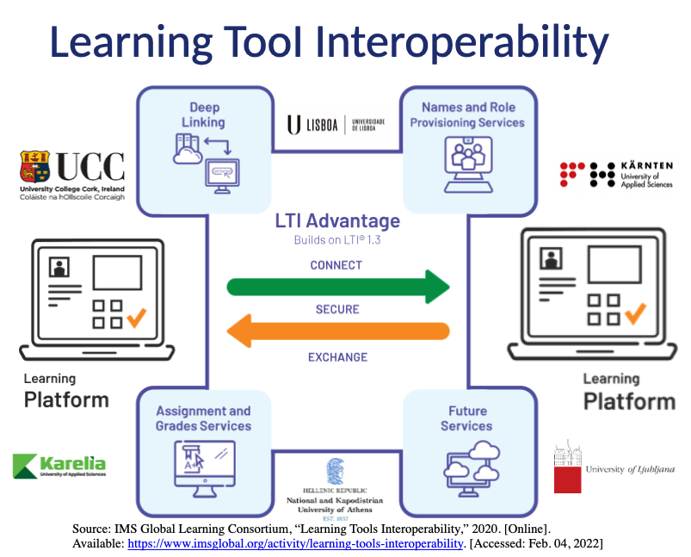
Building an Online Joint Program Platform Architecture for the „EMMA“ Project
Daniela E. Ströckl, Marvin D. Hoffland, Andrea Stitzel
Carinthia University of Applied Sciences, Villach, Austria - E-Mail: {d.stroeckl, m.hoffland, a.stitzel}@cuas.at
INTRODUCTION
The abbreviation “EMMA” stands for European Master on Active Ageing and Age Friendly Society. This project’s timeline is from 9/2020-8/2024 and six European higher education institutions from Austria, Finland, Greece, Ireland, Portugal and Slovenia are participating. The project aims to address the challenge of a fast-ageing Europe by developing an interdisciplinary, compatible and future-oriented Master Program within the framework of the European Approach for Quality Assurance of Joint Program (EQAR) [1]. The Master of Arts program (MA) will enable future professionals to develop knowledge and tools to systematically build inclusive societies to benefit the entire continent.
Active ageing aims to find new ways to engage older people in society even after retirement and thus enable them to continue to lead a meaningful life and even support economic sustainability [2]. An age-friendly society means creating environments that are truly age-friendly. This requires action in many sectors: health, long-term care, transport, housing, labor, social protection, information and communication, and by many actors – government, service providers, civil society, older people and their representative organizations, families and friends [3]. It also requires action at multiple levels of government. The EMMA MA therefore targets potential master students from diverse (undergraduate) degrees as well as professionals working in the field in various professions needing up-skilling and re-skilling.
The project’s goal is to design a novel MA where the content, tools and validation will be developed through seven tasks: Needs Assessments, Curriculum Framework, Core Modules, Elective Modules, E-Learning and E-Tools, Validation and Quality Assurance, and Accreditation. The major challenge of the project, among others, is to create a transnational online leanring environment that is user-friendly for teachers and learners alike.
1
Learning Management Platform | No. Selected | Normalized number | Comments
Moodle | 11 | 3
Canvas | 1 | 1
Others | 2 | 2 | Open Class Collaborate LTI connected with Moodle
2
Features | No. Selected | Comments
Tests / quizzes | 5 | Important to keep the students engaged
Material Sharing | 8 | Sharing reading material, literature
Multimedia capability | 6 | Sharing links to videos for later discussions
Student collaboration | 5 | Engagement of the students is one of the most important things.
Communication (forums, messaging) | 7 | Important feature for those who do not like to or do not feel comfortable speaking up.
Gamification | 1 | Awards, educational games
Evaluation (assignments, feedback) | 6 | Feedback necessary beside points / grades for assignments
3
Virtual Classroom Tool | No. Selected | Normalized number | Comments
Zoom | 5 | 3 | Zoom has better features than MS Teams It is easy to use, enables screen sharing, pools, breakout rooms, chat, raising hand option, easy access etc.
Microsoft Teams (MS Teams) | 3 | 3 | University restriction –MS Teams Teams in use but would like to use Zoom or even better BigBlueButton or Jitsi due to Moodle integration
BigBlueButton | 1 | 1 | Pro: easy to use, no installation needed; Con: just for meetings, no folder sharing possibility
Others | 1 | 1 | Collaborate: University uses it in Moodle, but also MS Teams is in use
4
Key Features in virtual classroom | No. Selected | Comments
Breakout Rooms | 9 | Working in small groups is important, sometimes more effective and the students' bond more easily. Good for smaller group discussion
Whiteboard | 1
Polls | 4 | Good for motivating discussions after
Recording | 7 | Importance depends on what is decided to be done: prepared lectures for students who watch them at their own convenience or have lessons live
Easy access - recordings | 1
File and screen sharing | 10 | Screen sharing is important when giving a lecture and also if students have to prepare something and have to or want to share with others when needed
Audio sharing | 4
Quick reaction | 2
5
Plagiarism detection system | No. Selected | Normalized number
Turnitin | 7 | 4
Urkund | 2 | 2
Unknown | 2 | 0
METHODS
The challenge in the development of a jointly usable online platform for a European Joint Program lies first in ascertaining the needs and restrictions of the individual partner universities. Therefore, an online short questionnaire was developed within the EMMA project to elicit these from the project partners. The participants had two weeks in the fall of 2021 to complete the questionnaire in order to give the development team of the virtual learning platform initial indications for the development and decision of the technologies.
CONCLUSION
The optimal solution in terms of the primary learning management system (LMS) to be used for the EMMA master program would be for one university to set up an independent server and host the LMS. This would ensure the same layout and structure of online courses for the EMMA students. However, due to a number of reasons (financing, licensing, security, etc.) this may not be a feasible option; thus, a novel concept of connecting the existing LMSs via learning tool interoperability (LTI) connections is being developed, tested, and evaluated. The idea is to establish an architecture where two (or three) universities LMSs function as hubs that host the online courses and ‘publish’ the courses as LTI tools. The basic concept is to adapt existing LTI services to securely connect and exchange data between learning platforms and not just between a learning platform and a learning tool. In this way, users (instructors and students) ‘subscribe’ via the LTI link (in Moodle, ‘External Tool’; in Canvas, ‘External App’) which is provided in a course on their respective university’s LMS to access learning resources and activities located on the host’s LMS . Roles such as instructors and students defined in the subscriber’s course are automatically transferred to the course on the hub, thus eliminating the need for account creation, role assignment and enrollment of students from seven different universities. Accounts, privileges, and rights of users are all defined on the individual user’s home university’s LMS and then via the LTI integration between the subscribers’ course and the publisher’s (hub) course, these user properties are easily and securely transferred to the respective courses located on the hub’s LMS. Additionally, with the proper configuration of the hub’s LMS course gradebook, composite marks/grades of the completed course can be automatically transferred back to the subscriber’s LMS course.
Initial LTI testing between the Carinthia University of Applied Sciences and the Karelia University of Applied Sciences Moodle platforms has yielded promising results. It is planned to expand the LTI connection to include more universities in the consortium with an emphasis on the non-Moodle platforms.
SURVEY RESULTS
The survey was sent out to the six partner universities - Karelia University of Applied Sciences: four, Carinthia University of Applied Sciences and University of Ljubljana: three, University College Cork, University of Lisbon and University of Athens - of the EMMA consortium. The results from questions 1, 3 and 5 show clear duplications in the responses as the same information was provided for the same institution. For this reason, the results of these questions are also shown below in a normalized version in order to show the use of individual platforms in the correct relationship.
As can be seen in Table 1 (Which learning management platform is your university using), most participants selected the use of the learning management platform Moodle; both in the total number and in the normalized number (one selection per university). Additionally, one participant indicated under "Others" that Moodle is not used directly but via a collaborate LTI connection. Nevertheless, Moodle is not used across the board in the participating European universities; platform technologies such as Canvas or Open Class are also used.
As shown in Table 2 (What three features do you feel are the most important to you in your platform?), the most important functions of a learning platform in the opinion of the questionnaire participants are that there is the possibility of easily sharing different learning materials (8 mentions), closely followed by an existing communication option (7 mentions). Reasons for this are seen above all in the fact that students have thereby a smaller inhibition threshold in order to communicate with their lecturers and fellow students. The functions "multimedia capability" and "evaluation" were also frequently mentioned; on the one hand that multimedia content can be used more easily for teaching purposes and on the other that evaluation offers added value for students, particularly through meaningful feedback.
As shown in Table 3 (What is your preferred virtual classroom tool and is this the tool that your university is using?) Zoom is commonly in use and preferred by the survey participants because of easy use and functionality. MS Teams is often used because of the combination of communication and storage functionalities in one platform. A platform rarely used even with integration with Moodle as a feature was BigBlueButton. Options like GoToMeeting, Skype4Business, Zoho or Jitsi were not selected.
In Table 4 (What are the key features you need in your virtual classroom?) the different key features lecturers prefer in the virtual classroom are mentioned. Key features most selected were file and screen sharing, breakout rooms to engage students easily and ease the online group discussions and work. For asynchronous lecture types, recording isalso necessary.
The last question was about the used plagiarism detection systems in the universities. As in Table 5 Qhat plagiarism detection system is your university using?) displayed, commonly used is the software Turnitin but not every university uses it; the Urkund system is also used.
REFERENCES (IEEE)
[1] EQAR, “eqar – Use and Interpretation of the ESG for the European Register of Quality Assurance Agencies”, https://www.eqar.eu/assets/uploads/2020/09/RC_12_1_Use And InterpretationOfTheESG_v3_0.pdf, last access: 04.02.2022.
[2] R. Fernandez-Ballesteros, “Active Aging: The Contribution of Psychology”, Hogrefe Publishing GmbH, Göttingen, Deutschland (2008)
[3] World Health Organization, “6. Towards an age-friendly world”, in WHO World Report on Ageing and Health, 2015, https://apps.who.int/iris/handle/10665/186463
ACKNOWLEDGEMENT The research leading to these results have been co-funded by the Erasmus+ Program of the European Union under GA No. 2020-1-FI01-KA203-066477.

